Slide 1
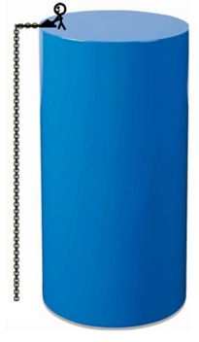
Bob the Builder stands on a cylinder 28 m above the ground. He needs to lift a 10 kg block from the ground by pulling on a chain attached to a winch. Assume there is no friction in the system and that the chain has a uniform density of 2 kg/m. How much work does Bob do to lift the chain and the block 28 m from the​ ground?
a. How much work is needed to pull the chain up onto the top of the cylinder without the block?
b. If the 10-kg block were attached, how much work is needed to lift it 28 m?

Slide 3
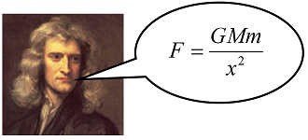
How much work is required to lift a 1000​-kg satellite from the surface of the earth to an altitude of 2.41​·10⁷ ​meters? The gravitational force is F as given by Sir Isaac to the right​,
where M is the mass of the​ earth, m is the mass of the​ satellite, and x is the distance between their centers. The radius of the earth is 6.4 ​·10⁶ meters, the mass of the earth is M​ = 6​ · 10²⁴ kg, and in these​ units, the gravitational​ constant, G, is 6.67​ · 10⁻¹¹.
(a) Report the force of the earth’s gravity on the satellite (i) at the earth’s surface. (ii) at an altitude 2.41​·10⁷ ​meters above the earth’s surface. (b) Report the amount of work done to lift the satellite to 2.41​·10⁷ ​meters.

