Slide 1
Canterbury Pilgrim Trail
A Travel Guide

Slide 2
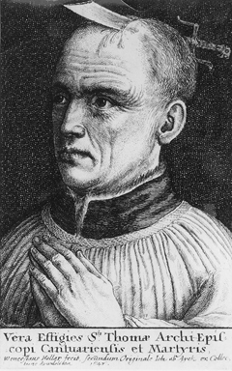
Is This Trip for You?
Are you mildly to moderately religious?
Do you want to take a sick vacation in the springtime?
Does walking 57 miles across the English countryside sound appealing?
Well this trip is for you! Stay tuned for all your travel tips and do’s and don’ts when making your pilgrimage to Canterbury cathedral to visit the brutally murdered Archbishop Thomas Becket.

Slide 3
Why Canterbury?
Thomas Becket was the Archbishop of Canterbury from 1162 until his murder in 1170. Becket had close ties with the English King, Henry II but fell into disagreement regarding monarchical versus ecclesiastic rights and privileges. After their quarrel, Henry had Becket brutally murdered at the alter of the Cathedral, which resulted in his martyrdom status. After Becket was canonized, Canterbury became one of the most popular pilgrim trails in the world, and the most famous trail in England.
Sounds like fun yet?!

Slide 4
When to start?
If you have decided that the Canterbury trail is the trip for you then let’s get started!
“Whan that Aprill with his shoures soote, The droghte of March hath perced to the roote.” In other words, when the spring showers have arrived in April it’s about time to get going on your pilgrimage. So with these extremely vague instructions let’s get going.
Travel Tip: Get one of those rain ponchos, walking through the English countryside in wet woolen clothing will literally be the worst.

Slide 5
Where to start?
For our purposes we will be tracking the pilgrim trail from London to Canterbury.
“In Southwerk at the Tabard as I lay,” Southwark is a fairly sketchy part of London in which all kinds of people congregate at a place called the Tabard, which is a tavern mind you, to begin their religious journeys. Now I know, this sound totally backwards, but I promise it’s going to be great.
Give yourself some extra time at the Tabard, maybe arrive the night before you plan to embark on your Pilgrimage, that way you can meet loud drunk dudes, watch some nuns eat, and be judged harshly by a tiny man who is writing down his observations about you and everyone else present.

Slide 6
Who to go with?
A pilgrimage can of course be done solo, but no pilgrimage is better then joining forces with twenty-nine random strangers to embark on a 19 hour walk across England. These strangers can, of course, be found at the Tabard.
Make sure to include the tavern proprietor in these strangers because apparently, he can leave all his responsibilities behind without a thought. He will also be an essential factor in creating lifelong friendships between your fellow travelers and yourself.
Travel Tip: Stay sober and stick to yourself in this group, you never know what kind of tricksters you have among you. Also, don’t believe the Hosts’ promises, he will undoubtedly let you down.

Slide 7
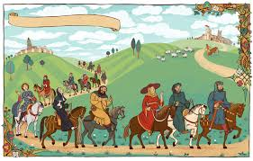
What to expect?
The travel time between London and Canterbury cathedral is roughly 57 miles, meaning that at a non-stop, steady walking pace you will be on route for about 19 hours. However, if you are fortunate enough to have a horse for this journey, we can probably reasonably knock off maybe 5ish hours. Either way, get ready to spend a pretty long day in the English countryside with a bunch of strangers.
Travel tip: Get some good hiking boots and/or rent a good quality horse. Maybe some of those sick walking sticks.

Slide 8
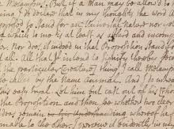
How to stay entertained?
“To Canterburyward, I mene it so, and homeward he shall tellen othere two, of aventures that whilom have bifalle.”
Make sure you have a sharp imagination and don’t get offended too easily with this bunch! Your fellow travelers are the perfect way to keep yourself entertained along the way. Obviously, there will be no iPhones or in-flight movie seeing as how this is medieval times and that witchcraft has not been invented yet. Therefore, you will have to rely on the imagination of your fellow travelers to keep you entertained with tales.
Travel Tip: If dirty stories are offensive to your delicate nature, ear plugs are probably the most cost-effective way to protect yourself. Also, even though the Host promised you a turn to tell a tale, don’t hold your breathe, you’ll probably be forgotten or interrupted. Like I said, he will most certainly let you down. Don’t take it personally.

Slide 9
What to Avoid?
“The Millere is a cherl, ye knowe wel this, So was the Reve, and othere manye mo, and harlotrie they tolden bothe two.”
If you happen to find yourself amongst a Miller, a Reeve, or a sketchy pair of dudes that go by the professions Summoner or Pardoner, it’s in your best interest to go to the back of the pilgrim procession in order to avoid them. They have big ‘cherl’ energy and you don’t want that for your peaceful pilgrimage.
Travel Tip: Don’t be tricked into buying relics along the pilgrim trail, these are most certainly fake.

Slide 10
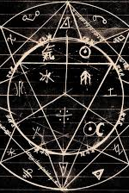
Beware
“A man that clothed was in clothes blake, And undernethe he hadde a whit surplus. His hakeney, that was al pomely gris, So swatte that it wonder was to see; It semed as he hadde priked miles three.”
There is a very real possibility your company will be approached by random strangers who seem to be fleeing for their lives from the nearest towns. Don’t be alarmed or feel pity, they are also, cherls.
Travel Tip: Don’t let anyone convince you that alchemy is real along the way, it is not, and you will lose all your money.

Slide 11
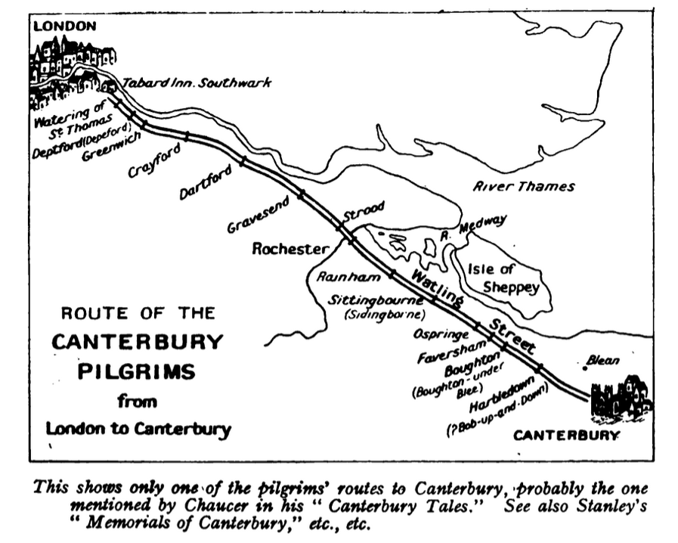
Trail Breaks
Don’t worry, there are plenty of places to break along the way in the event of poor weather, or your companions have driven you to insanity.
Travel Tip: The provided map is always a good idea to have a copy of for emergency situations, familiarize yourself with the land.

Slide 12
What to Bring?
Plenty of food and water of course.
Rain ponchos and/or umbrellas will do.
A set of dry/clean woolen clothes.
A healthy horse (although a mule will suffice).
A developed sense of humor.
Paper and ink if you enjoy writing stories down.
Money, but don’t let anyone know you have it.
Travel Tip: Reusable water bottles go a long way.

Slide 13
Off you go!
You are ready to embark on your journey to visit a dead dude! What an exciting vacation! This experience is like none other that the medieval time period has to offer. Stay hydrated and don’t let anyone swindle you! This journey will change you forever and redefine your expectations of people and their morals, have the best time ever!

